Slide 1
Vehicle Hauling Management System
By Cengiz Han Beslen & Chau Minh Nguyen
CMP669 Project

Slide 2
Project Description
Smart App is software solution for car carrier companies to:
Run on Web browser or Mobile app
Dispatch, track, and control the loads
Inform clients with location and date of the load
Allow driver to do inspection with images of the loads and record them to the database
Recording expenses
Report all transactions
Generating reports such as expenses, revenues, and payroll
Generate invoice at the end of transaction
Track their assets status such as parts, services and mileage
Reporting the performance of each asset.

Slide 3
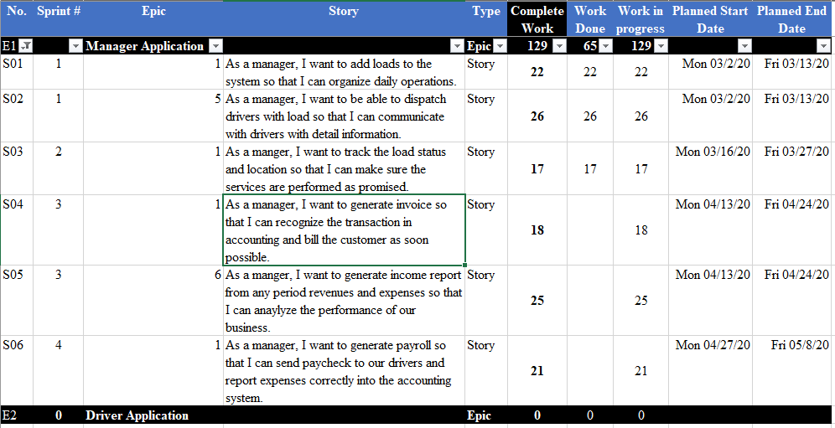
Product Backlog Report

Slide 4
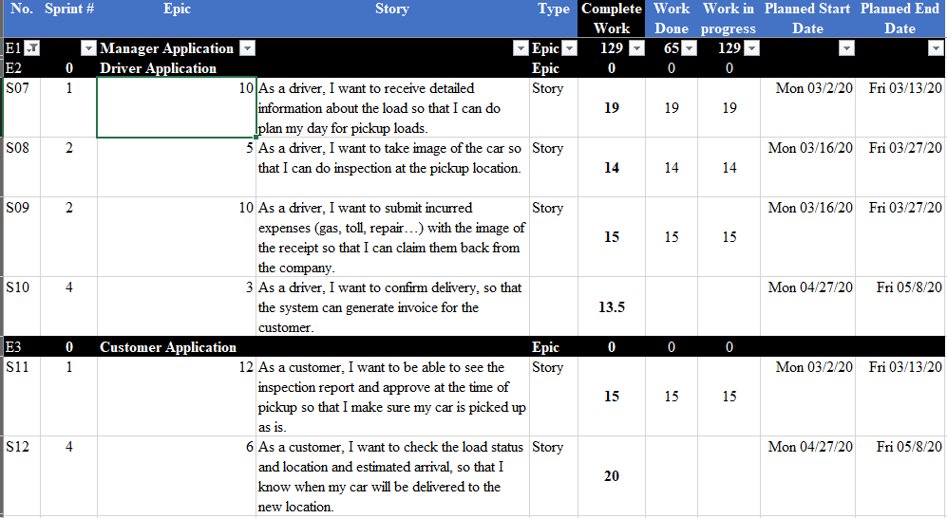
Product Backlog Report (cont)

Slide 5
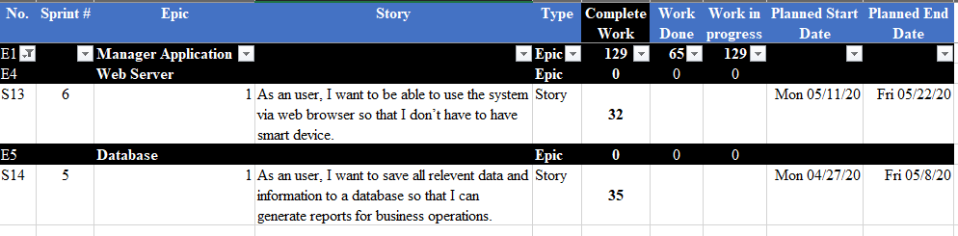
Product Backlog Report (cont)

Slide 6
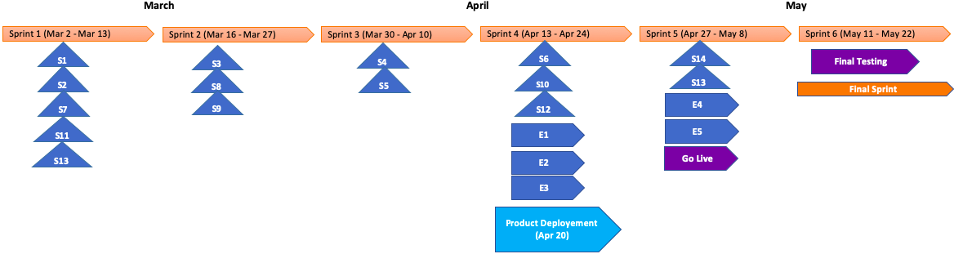
Product Road-Map Report

Slide 7
Sprint Backlog Report

Slide 8
Sprint Backlog Report (cont)

Slide 9
Sprint Backlog Report (cont)

Slide 10
Sprint Backlog Report (cont)

Slide 11
Sprint Backlog Report (cont)

Slide 12
Sprint Backlog Report (cont)

Slide 13
Burndown Chart Report

Slide 14
Burndown Chart Report (cont)

Slide 15
Burndown Chart Report (cont)

Slide 16
Burndown Chart Report (cont)

Slide 17
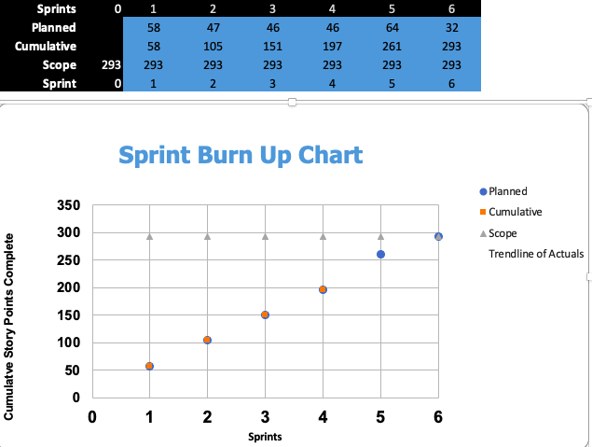
Burnup Chart Report

Slide 18
Release Velocity

Slide 19
Iteration Review Status Report

Slide 20
Iteration Retrospective Report

Slide 21
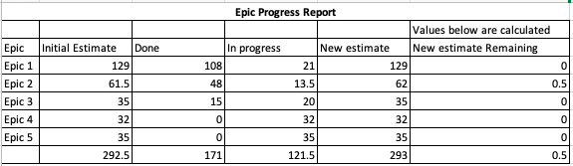
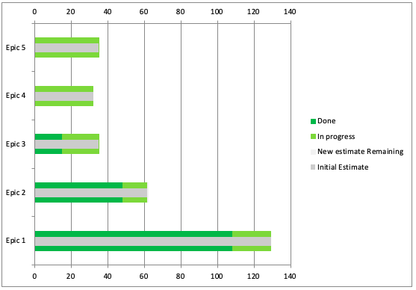
Epic Progress Report

Slide 22
Cumulative Flow Diagram

Slide 23
MVP Definition of Done
Code peer-reviewed
Acceptance criteria met
All test cases for user stories passed
Integration tests passed
Documentation updated
Pre-production app run on top 5 browsers
Pre-production app run on top 3 mobile devices
System-level NFR (performance) is tested and passed
TEST
Mobile devices
APPROVAL
Acceptance criteria
Browsers
peer review
User stories
Integration
Performance
Documentation
DEVELOP

Slide 24
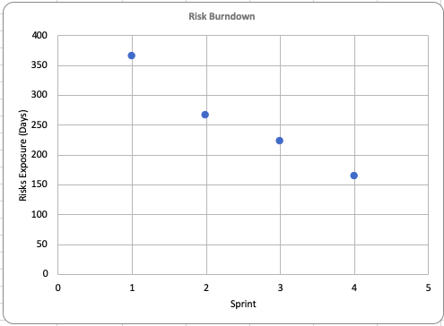
Risk Burndown Chart
Sprint | Risks Exposure (Days)
1 | 365
2 | 266
3 | 223
4 | 165

Slide 25
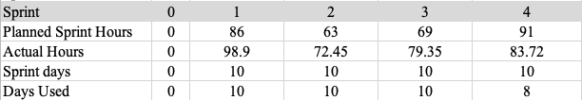
Team Burn Rate
Sprint: 4
Planned burn rate: 9.1
Actual burn rate: 10.465

Slide 26
Resource Utilization
Sprint: 4
(A) total hours of all team: 83.72
Cengiz: 75% 6 h/day
Chau: 50% 4h/day
(B) team: 10h/day
(A/B) Days used for this sprint: 8.4 at the end of Day 8

Slide 27
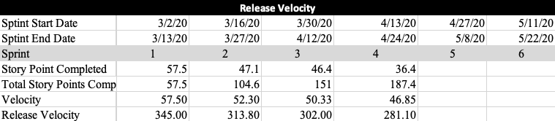
Release Velocity
Sprint: 4
Total Story points completed: 187.4
Velocity: 46.85
Release velocity: 281.1

Slide 28
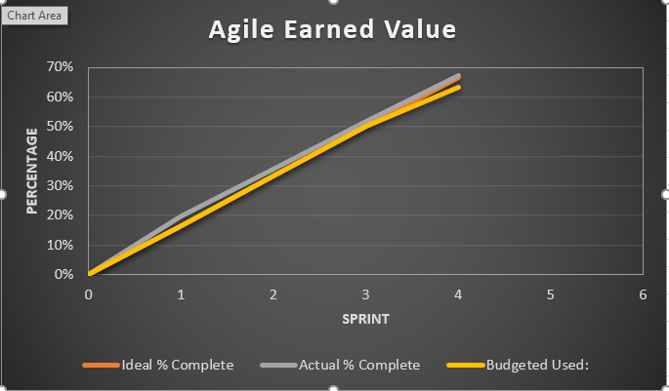
Agile Earned Value

Slide 29
The End!

